Slide 1
Decentralized wastewater solutions in rural areas
GWP experiences in the Danube region
Darja Istenič, PhD

Slide 2
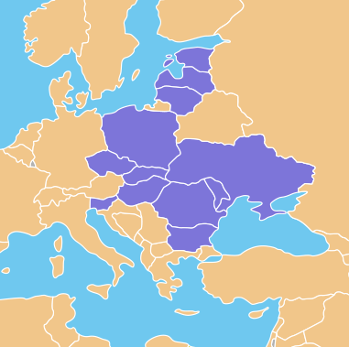
Global Water Partnership
Central and Eastern Europe
Population of 152 million
12 countries in Baltic and Danube
Area of over 2.03 million km²
Network of partners to create water secure world
GWP CEE currently joins 160 partners
NGOs, water utilities, governance, companies, academia, etc.

Slide 3
Sanitation in CEE
Lack of sanitation in small settlements
30% of population lives in settlements with less than 2000 inhabitants (= 42 million people)
9% of these are so far connected to WWTP (GWP, 2011)
Lack of awareness and knowledge
Lack of proper managerial and operational practices
Legislation gap
Urban WW Directive: WWTP for settlements < 2000 PE are not obligatory
BUT countries are obliged to meet the goals of WFD – to achieve good status of waters
Pollution of surface and groundwater

Slide 4
Sustainable sanitation Task Force
Future WWTPs in small settlements
Which technologies?
Water and nutrient management
Sustainable sanitation
Investment costs, operation and maintenance

Slide 5
Sustainable sanitation Task Force
Wastewater
Agriculture
Nutrients
Water
Micropollutants
Fertilization
Irrigation

Slide 6
Sustainable sanitation Task Force
2007-2014
Book: Sustainable sanitation in small and medium settlements
Study: Actual status on natural wastewater treatment
Guidebook: Natural technologies of wastewater treatment
2016
Project: SANDANUBE Sustainable sanitation in small settlements of the Danube Region
2017
Project: Synthesis centres on innovative wastewater treatment: feasibility studies in the Lower Danube
2018
COST action: Implementing nature based solutions for creating a resourceful circular city
2019
MoU: between GWP CEE and IAWD
Project application: DANURECO Decentralised regenerative wastewater and nutrient management in the Danube Region

Slide 7
SANDANUBE
Sustainable sanitation in small settlements of the Danube Region

Slide 8
SANDANUBE
Focus on Danube Region
The demographic situation indicates a significant rural population
Activities
Stakeholder mapping
Workshop
Preparation of project proposal

Slide 9
SANDANUBE
To obtain better policy on WW management and its implementation in rural areas
To increase capacity of stakeholders on sustainable WW management
To set a firm background for renovation of policies regarding sustainable sanitation
To establish a cross-sectoral network involving local decision makers, governmental institutions, NGOs, companies and research institutions
→ DANURECO 2019

Slide 10
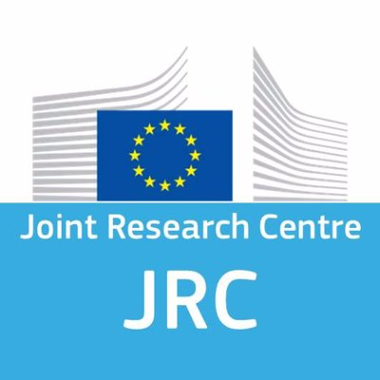
SYNTHESIS CENTRES ON INNOVATIVE WASTEWATER TREATMENT
feasibility studies in the Lower Danube

Slide 11
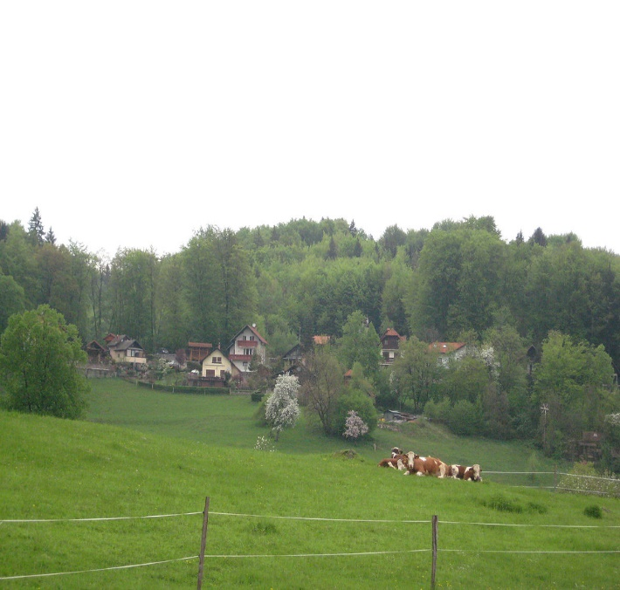
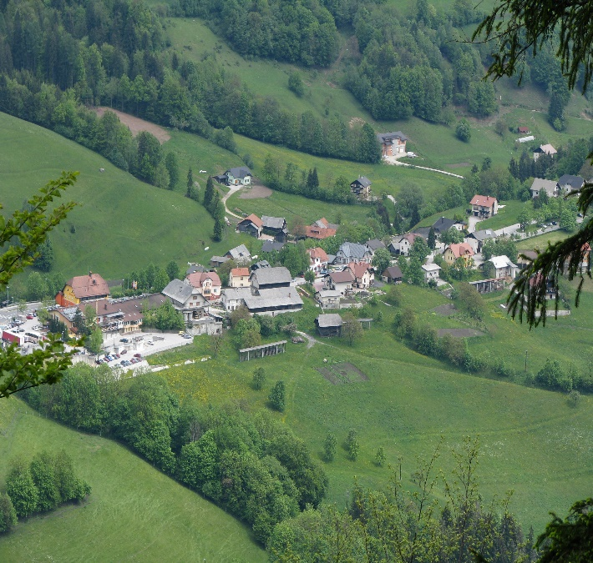
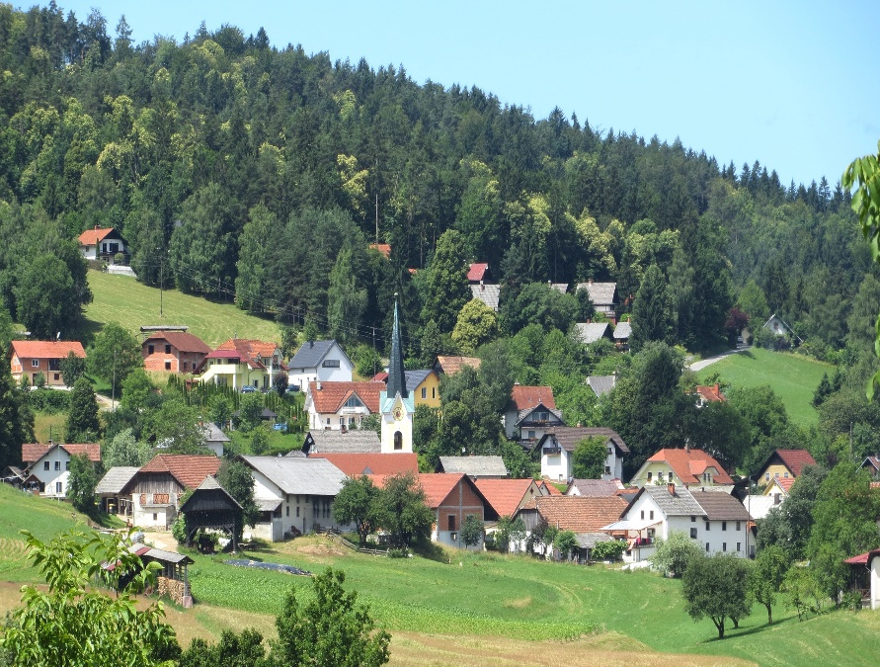
Feasibility study
Comparison of different scenarios for collection and treatment of wastewater in small settlements
Study area: 3 small settlements in the catchment of Kamniška Bistrica, Slovenia

Slide 12
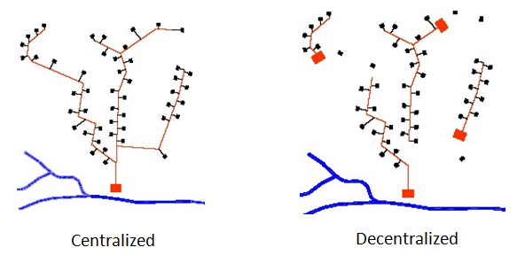
Feasibility study
Scale
Centralized
Decentralized

Slide 13
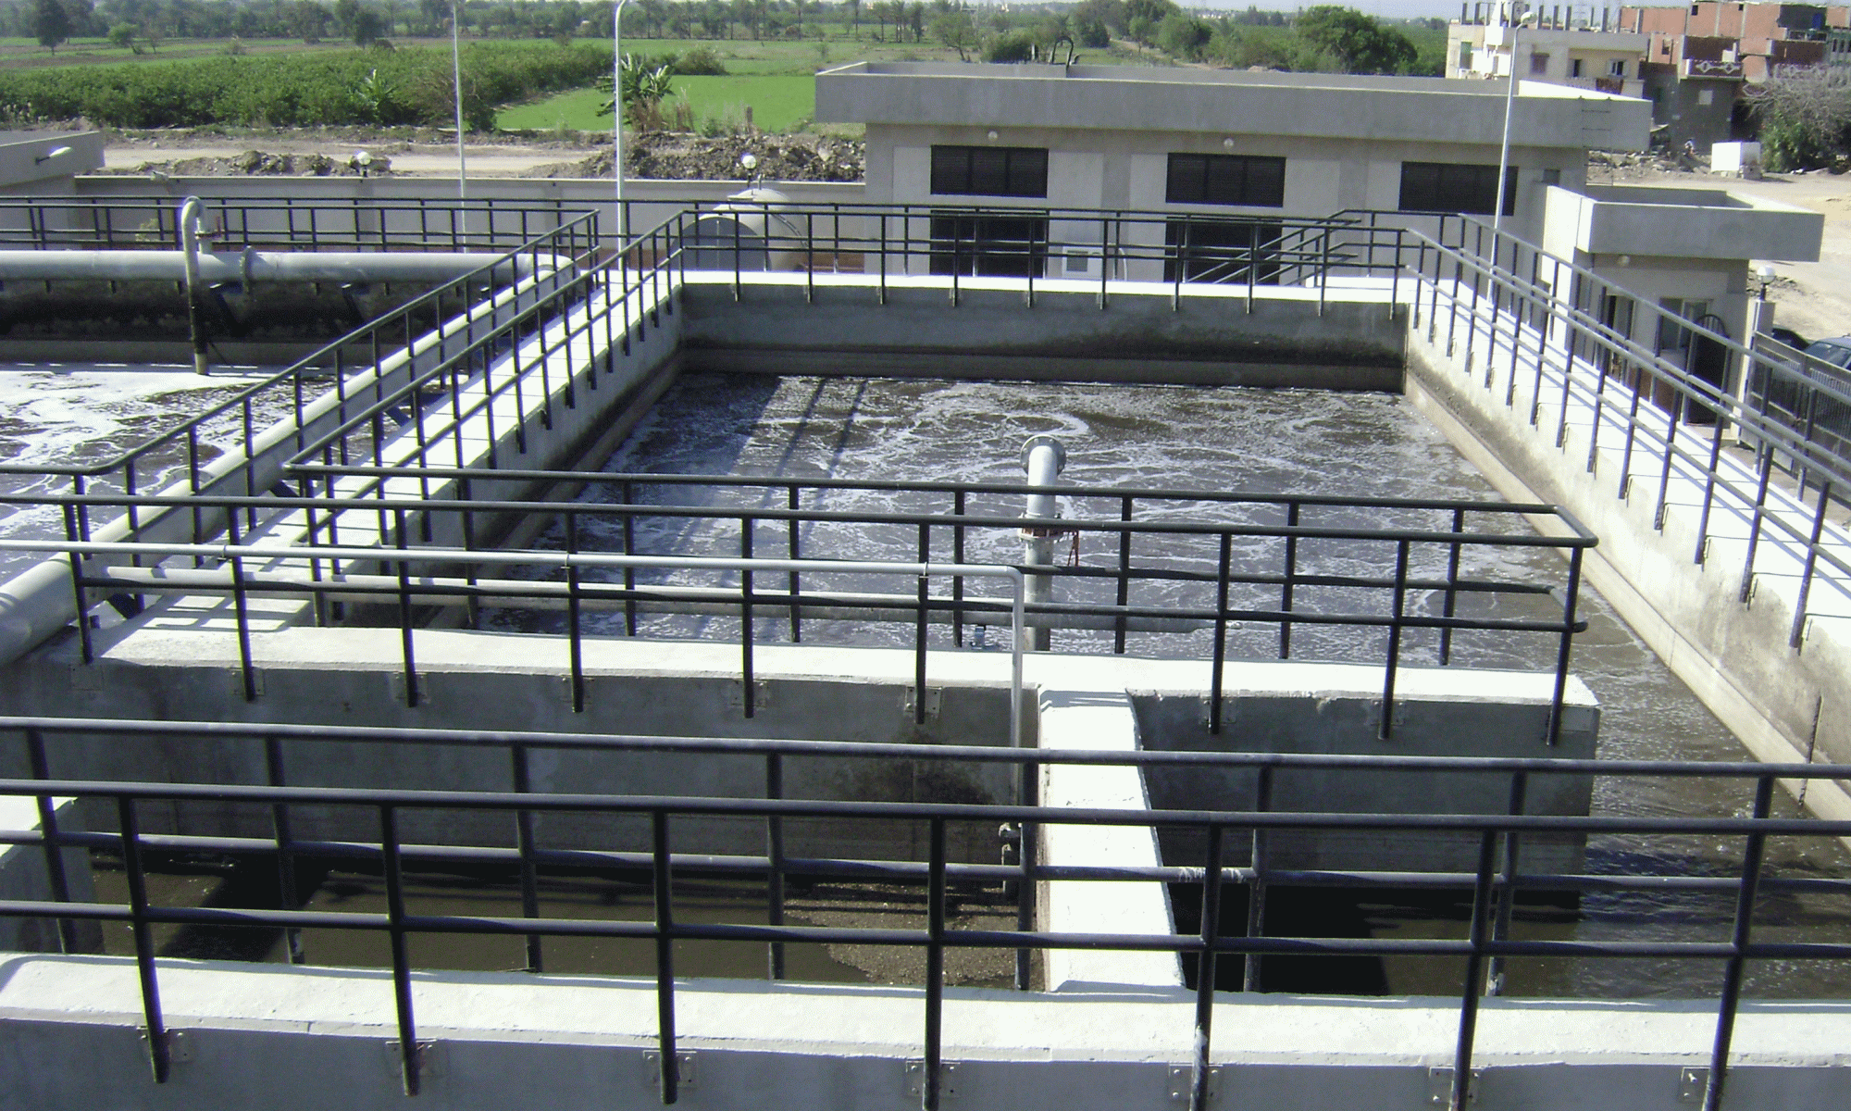
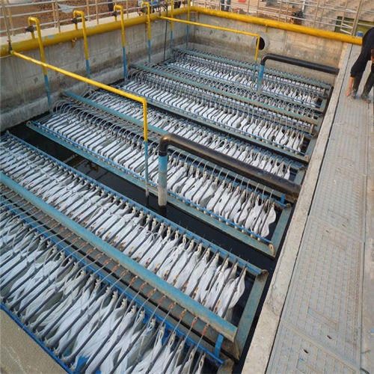
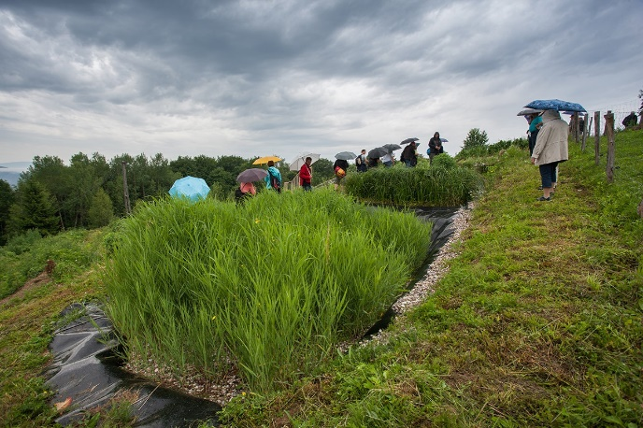
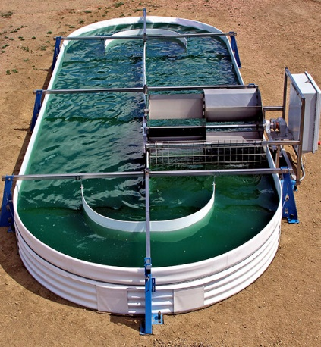
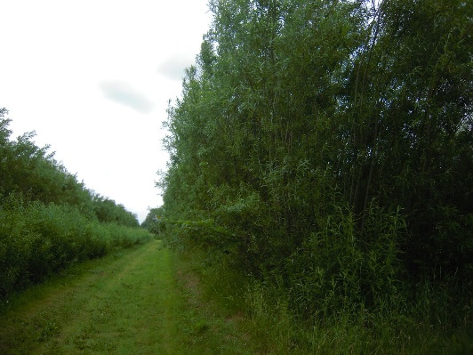
FEASIBILITY STUDY
Technology
High-tech
Sequencing batch reactor (SBR)
Membrane bioreactor (MBR)
Nature based
Forced bed aeration constructed wetland
French constructed wetland
Hybrid constructed wetland
Horizontal flow constructed wetland
Vertical flow constructed wetland
Resource-oriented
Algae bioreactor
Willow system

Slide 14
Feasibility study
Criteria
Investment costs
Operational parameters
OM costs, energy requirements, reliability, skills required
Socio-economic aspect
Water quality improvement, wellbeing, innovation, reuse etc.
Multicriteria evaluation of options and selection of best solution

Slide 15
Feasibility study
Results
Decentralized approach enables numerous advantages (economic, social and environmental), but only if roboust technologies are applied that do not need a lot of maintenance.
This needs to be taken into account in decision making

Slide 16
Conclusion
GWP CEE promotes NBS as robust technologies that can offer integrated water management including water and nutrient reuse, draught protection and flood mitigation
There is a need to continue activities to raise awareness at “policy level” and attract governmental institutions
There is a need to bridge the knowledge gap and to support better dialog between scientific community and practitioners/policy level
Many good practices already exist in CEE and Danube region which offer good opportunities for knowledge transfer and further dissemination
GWP CEE – multi stakeholder platform; can further support regional activities through our diverse partner network

Slide 17
Thank you

